Slide 1
PYTHON DATATYPES AND IT’S METHODS

Slide 2
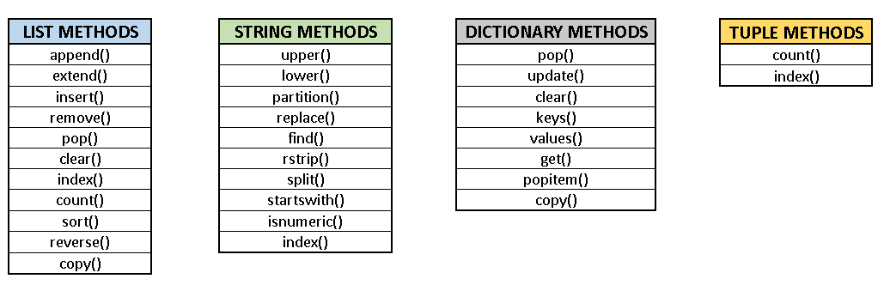

Slide 3
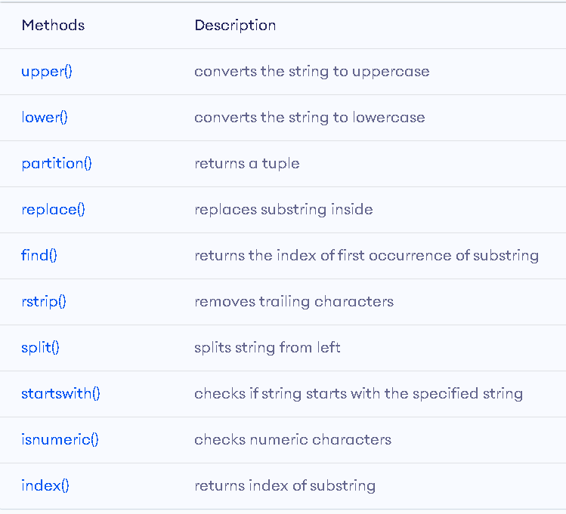
PYTHON STRING METHODS

Slide 4
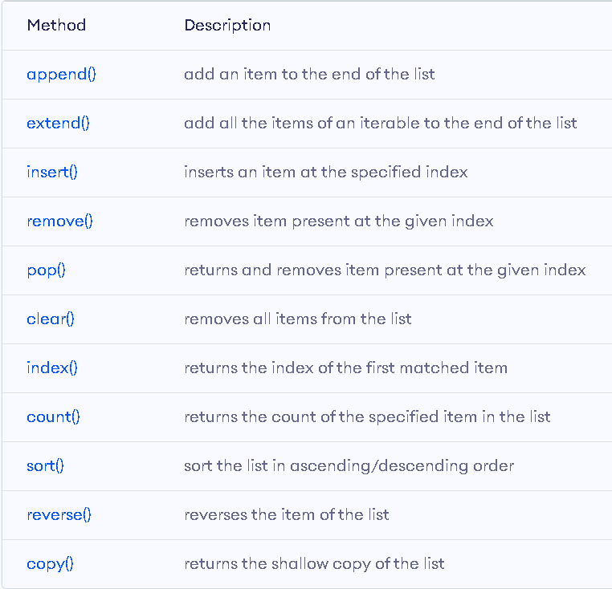
PYTHON LIST METHODS

Slide 5
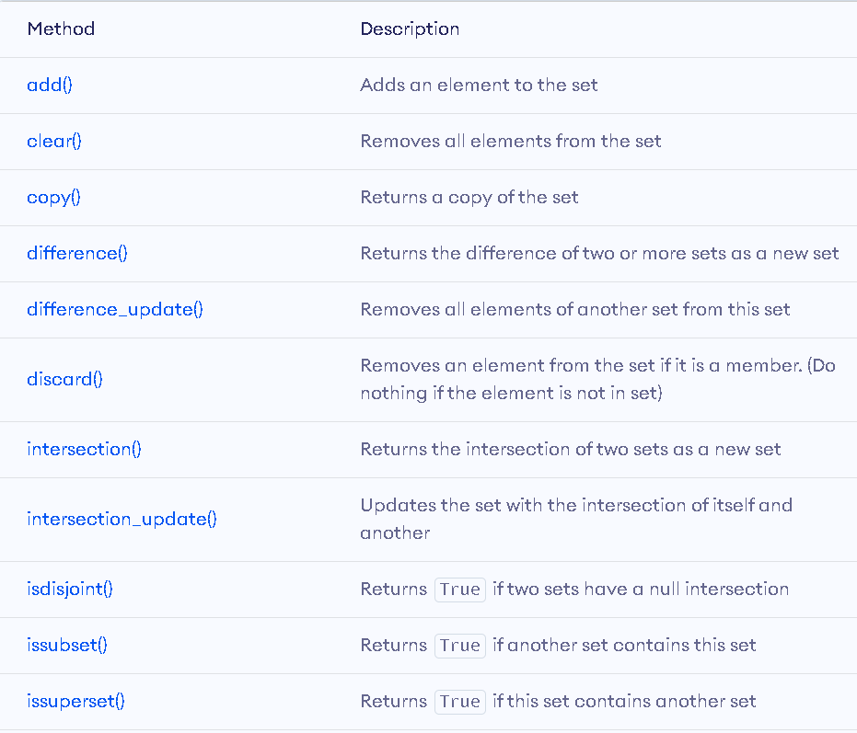
PYTHON SETS METHODS

Slide 6
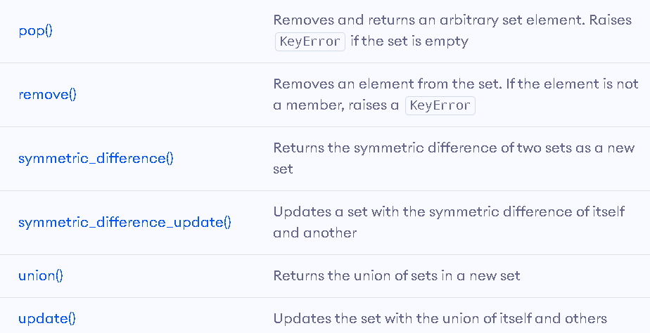

Slide 7
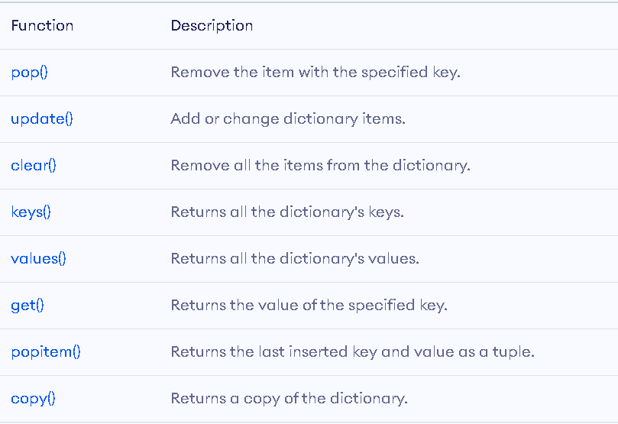
Python Dictionary Methods

Slide 8
PYTHON TUPLES METHODS
Tuples have only two methods, those are
Count() : returns the count of the specific item from the list.
Index() : returns the index of the first matched item.

Slide 9
THANK YOU

